Slide 1
NodeJS
JavaScript Server

Slide 2
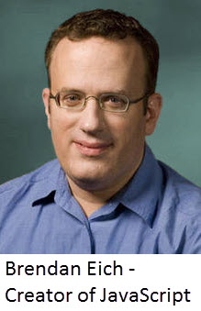
Introduction to JavaScript
JavaScript was developed by Brendan Eich in 1995, which appeared in Netscape, a popular browser of that time.
The language was initially called LiveScript and was later renamed JavaScript.
There are many programmers who think that JavaScript and Java are the same. In fact, JavaScript and Java are very much unrelated.
The syntax of JavaScript is mostly influenced by the programming language C.

Slide 3
Versions of JavaScript
May 1995 originally developed under name Mocha
September 1995 Realsed as LiveScript
December 1995 - Renamed as javascript with release of netscape navigator.
November 1996 - Netscape submitted javascript to ECMA for standardization
June 1997 - This resulted in new language standard, know as ECMAScript.
ECMA Script is the standard and Javascript is the most popular implementaion of that standard.

Slide 4
Where JavaScript Runs ?
Prior to introduction of Node.js JavaScript was just a language that could run on browser.
As a programmer we don’t need to worry about the OS as every modern browser supports JavaScript
To start with, you need a text editor to write your code and a browser to display the web pages you develop.

Slide 5
JavaScript Key features
Event based
Functions are first class citizens
Dynamically typed
var x; Vs int x=10;
x=10;
Single threaded
Closures
Prototypal Inheritance

Slide 6
JavaScript datatypes
Primitive Types
String
Number
Boolean
Undefined
Reference Types
Object
Array
Function
Date
Regex

Slide 7
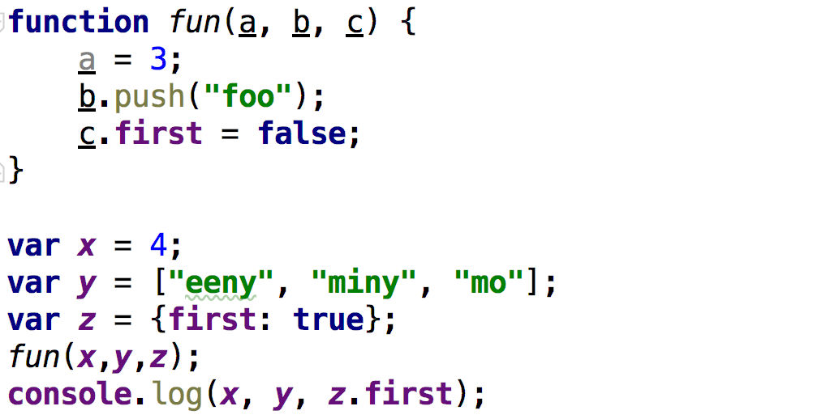
Guess the output

Slide 8
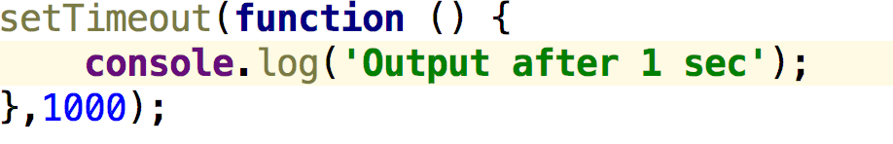
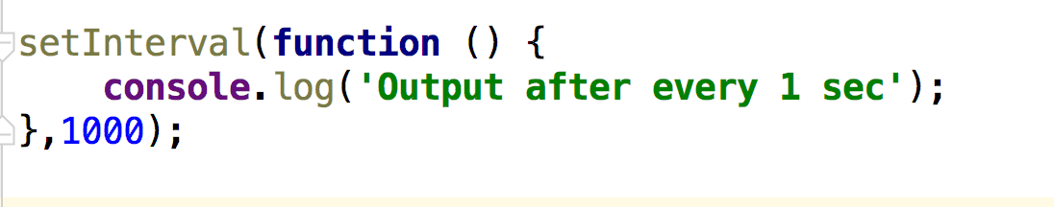
Timer functions
SetTimeout()
The setTimeout() method calls a function or evaluates an expression after a specified number of milliseconds.
SetInterval()

Slide 9
Timer functions
clearTimeout()
The clearTimeout() method clears a timer set with the setTimeout() method.
clearInterval()
The clearInterval() method clears a timer set with the setInterval() method.

Slide 10
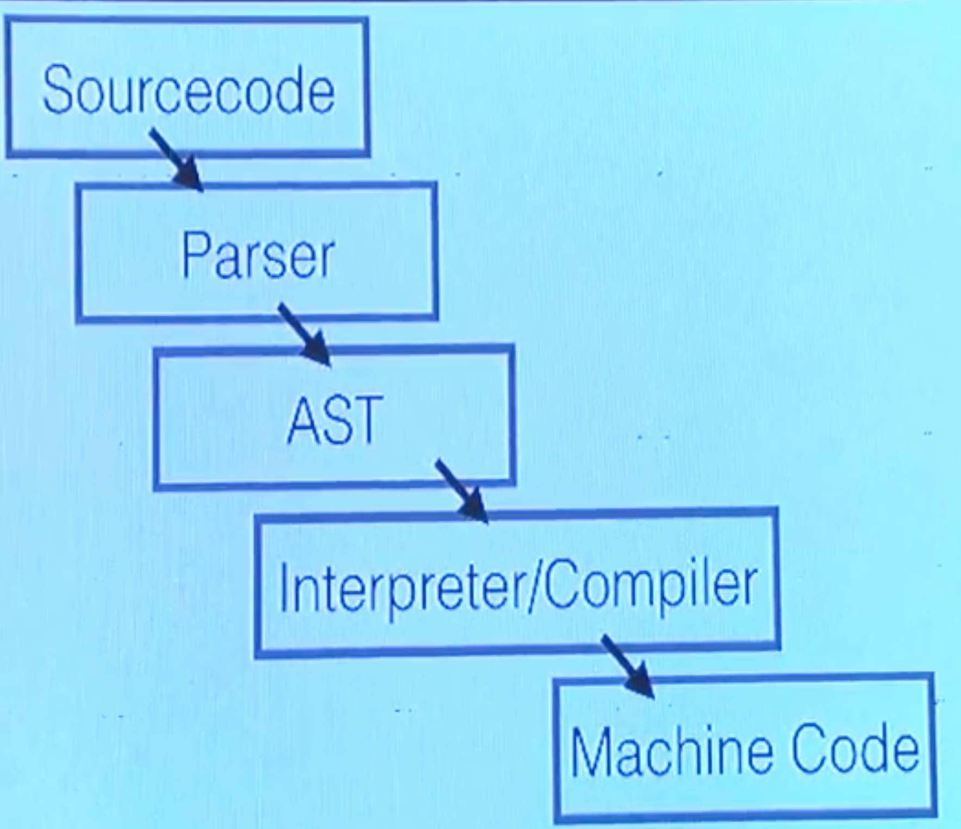
How JavaScript Executes ?

Slide 11
Just In Time Compilation (JIT)
Generate machine code during runtime, not ahead of time (AOT).

Slide 12
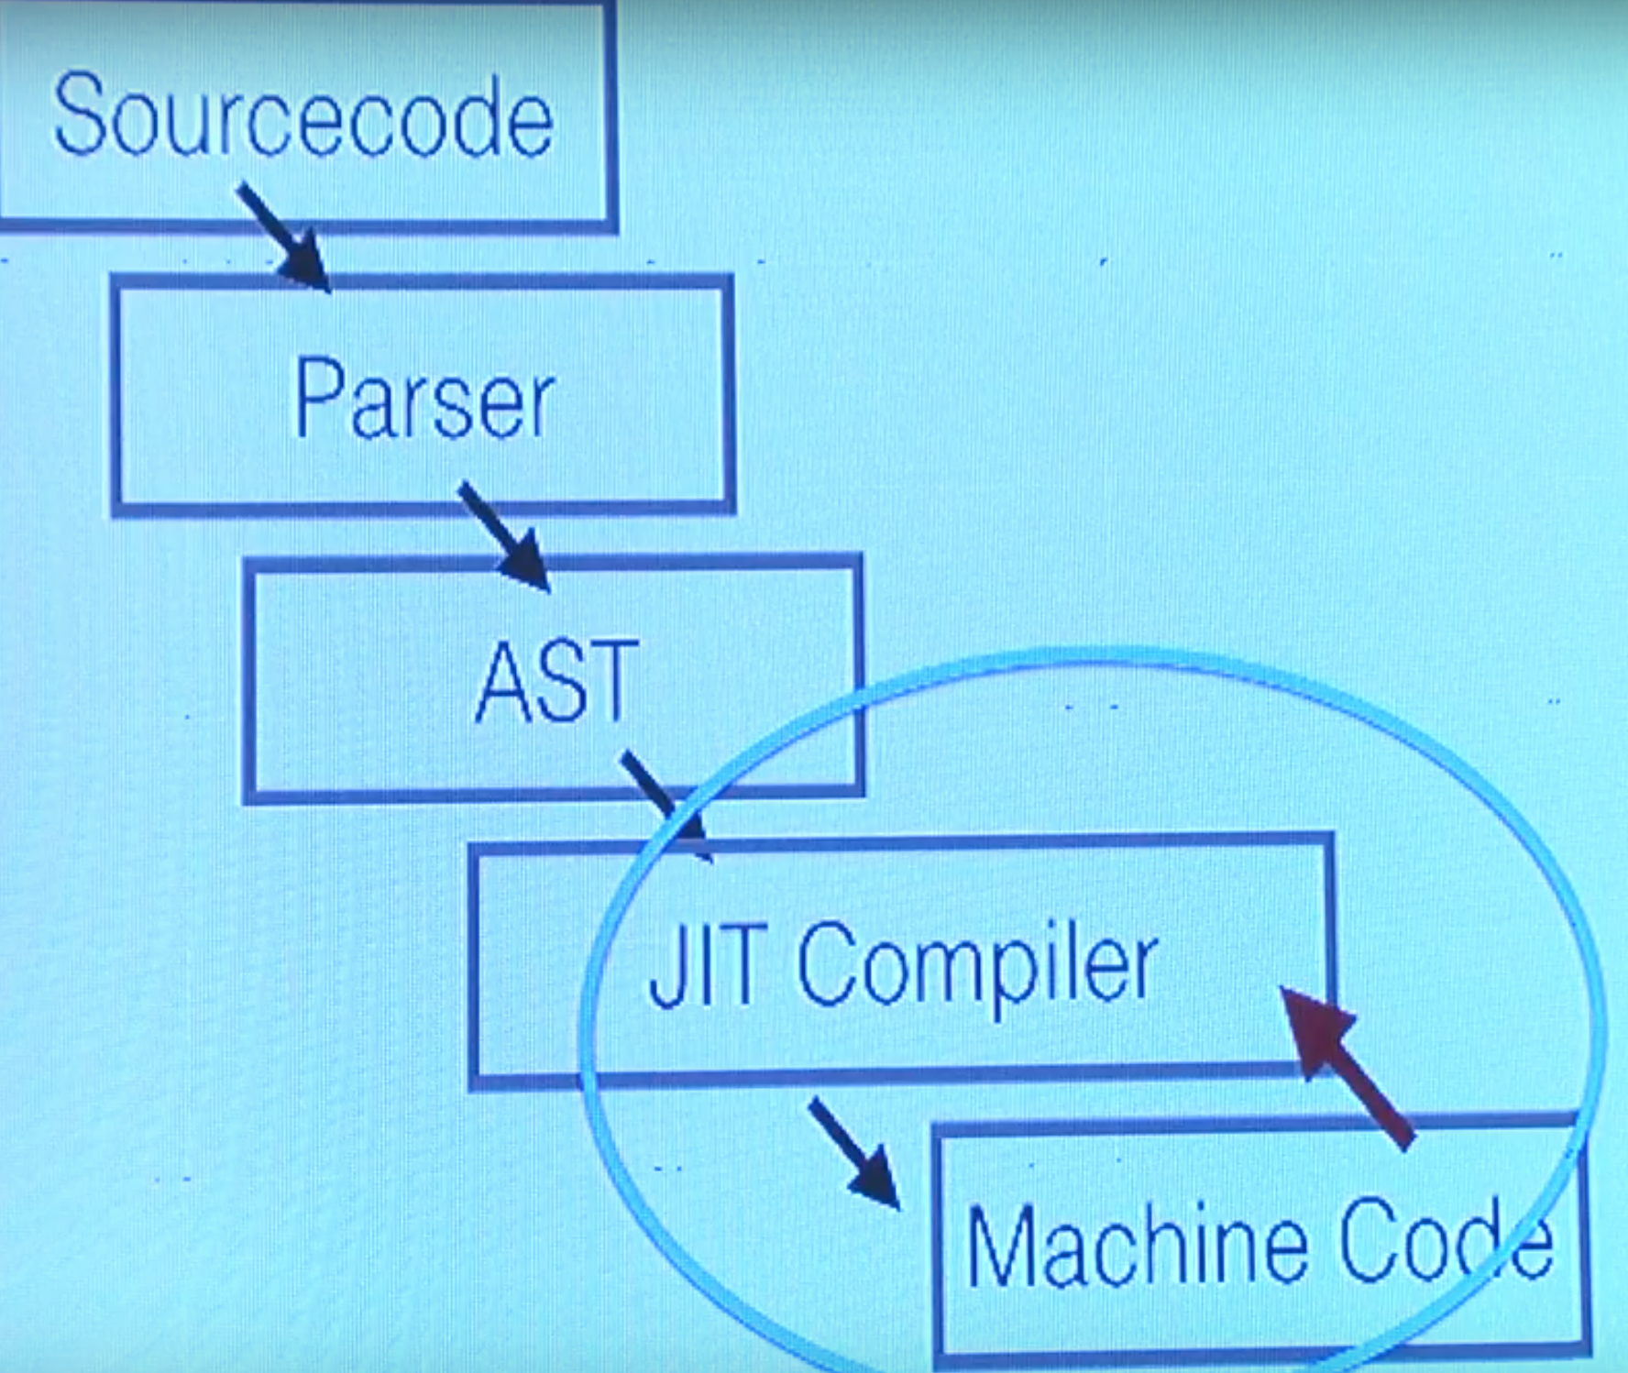
JIT

Slide 13
JavaScript Execution
JavaScript is executed in two phases
Compilation Phase
Executions Phase
During compilation phase JavaScript engine just prepares the memory with references.
During execution phase JavaScript engine assigns values to the references

Slide 14
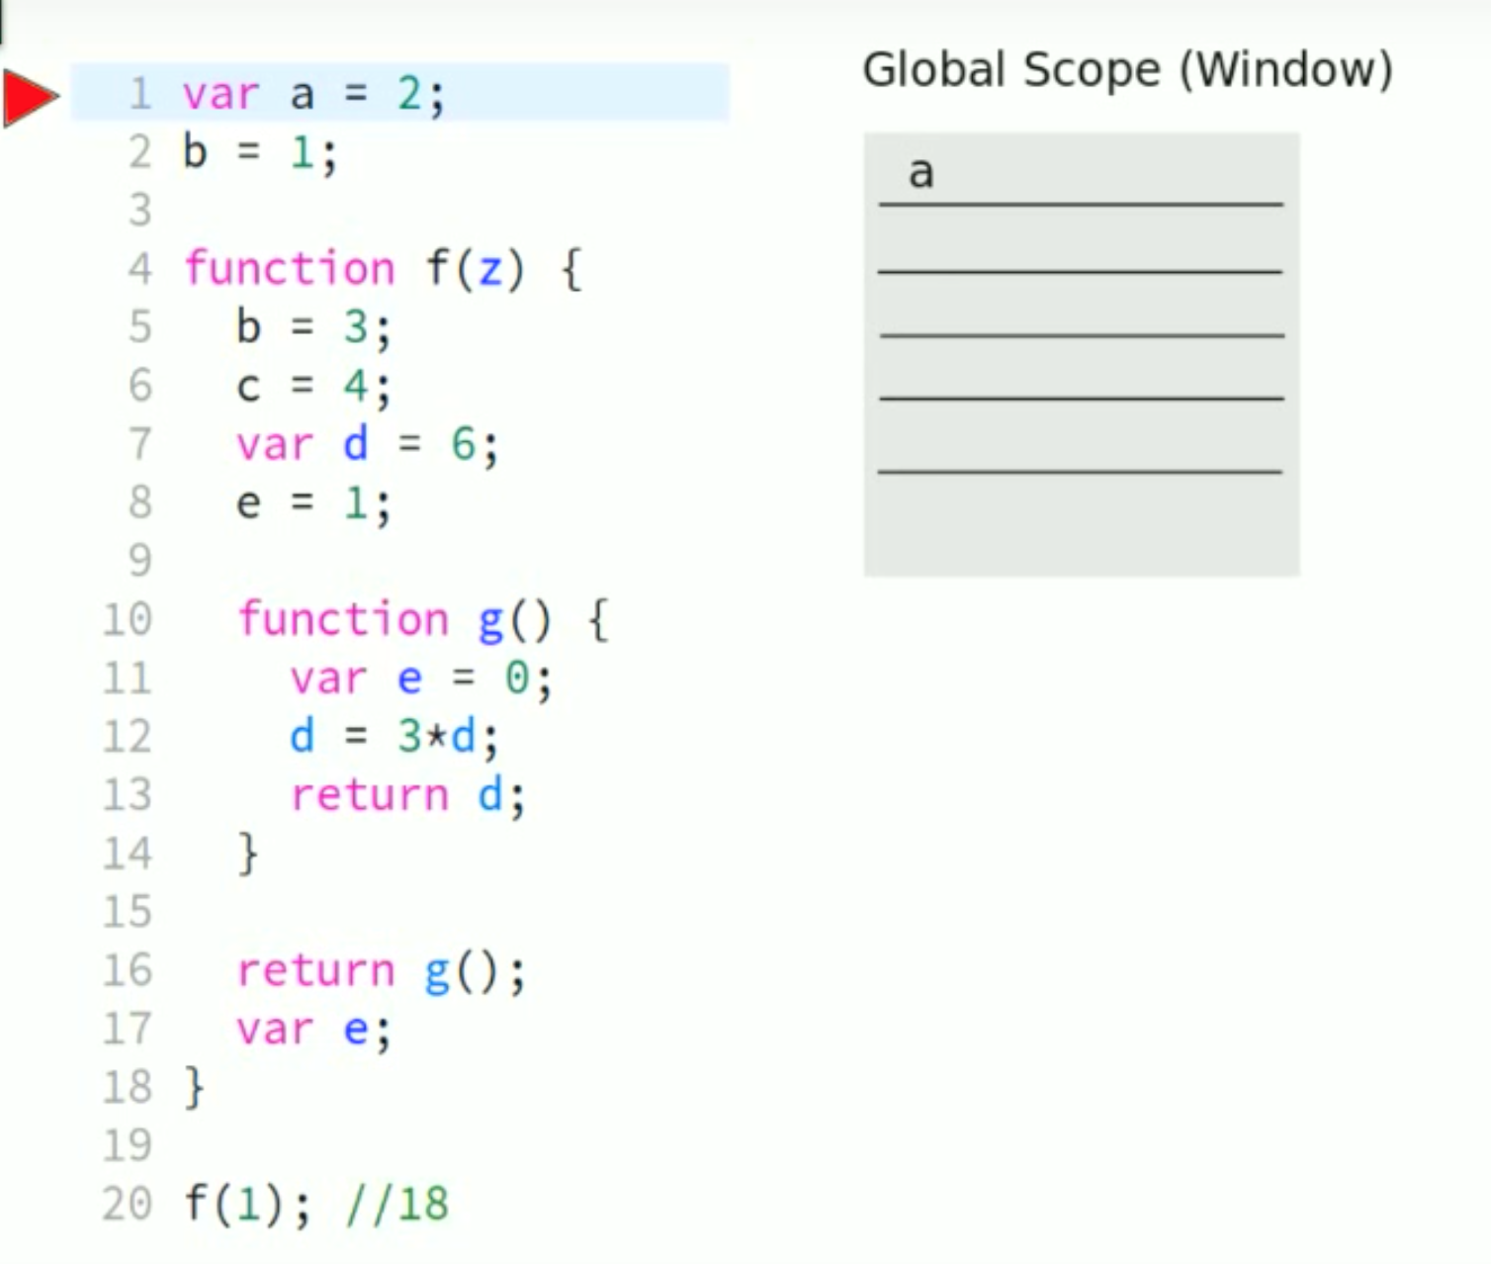
JavaScript Execution

Slide 15
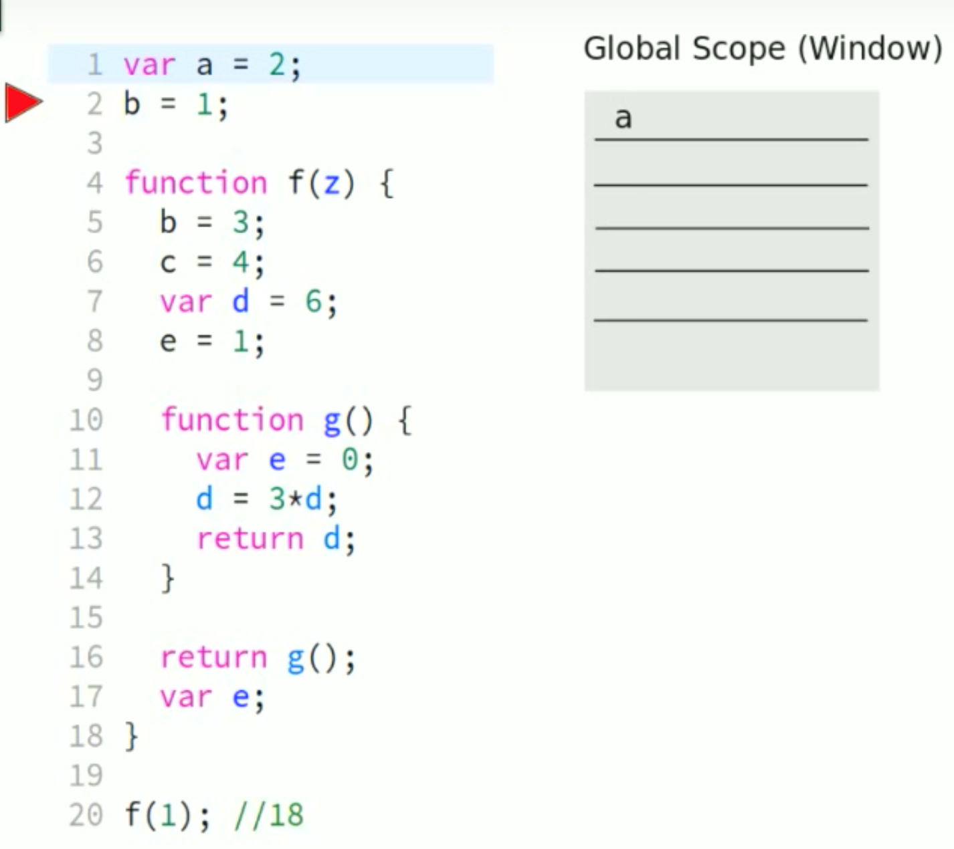
JavaScript Execution

Slide 16
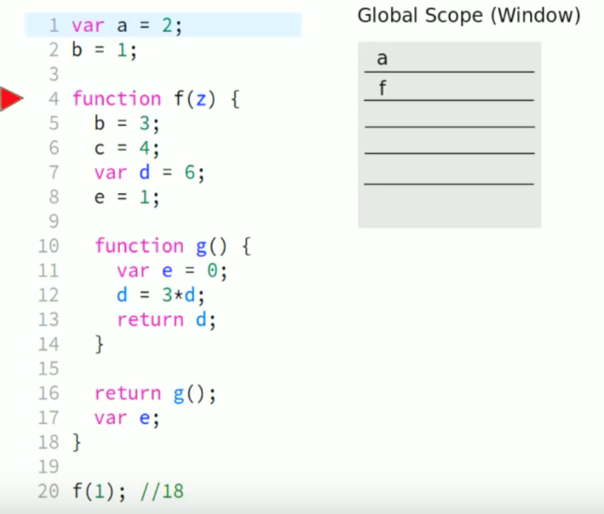
JavaScript Execution

Slide 17
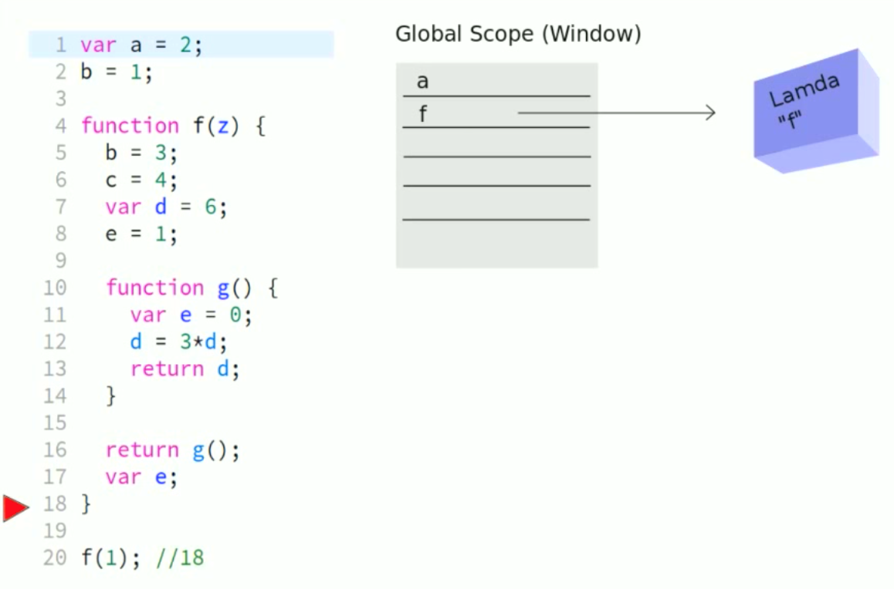
JavaScript Execution

Slide 18
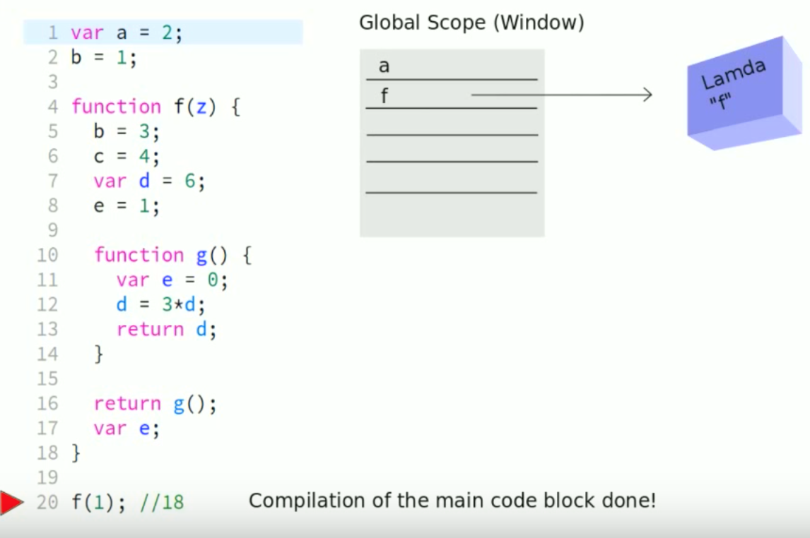
JavaScript Execution

Slide 19
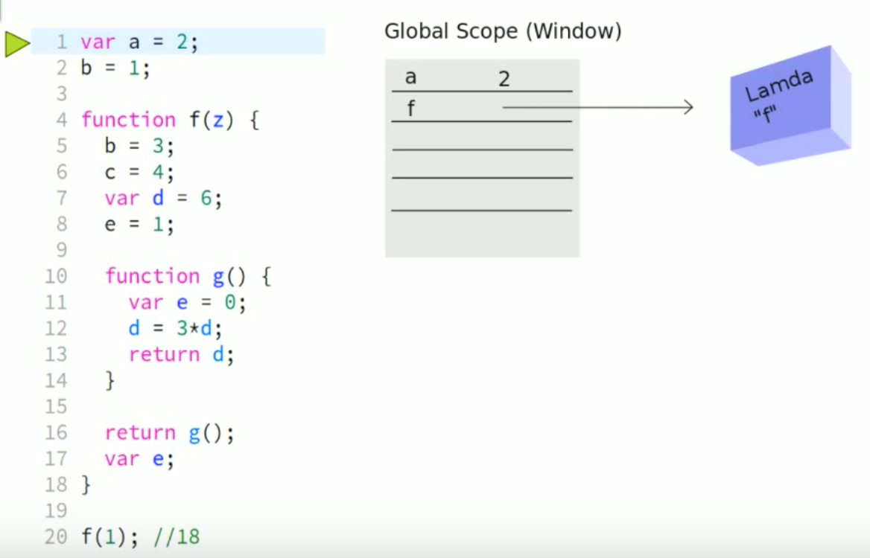
JavaScript Execution

Slide 20

JavaScript Execution

Slide 21
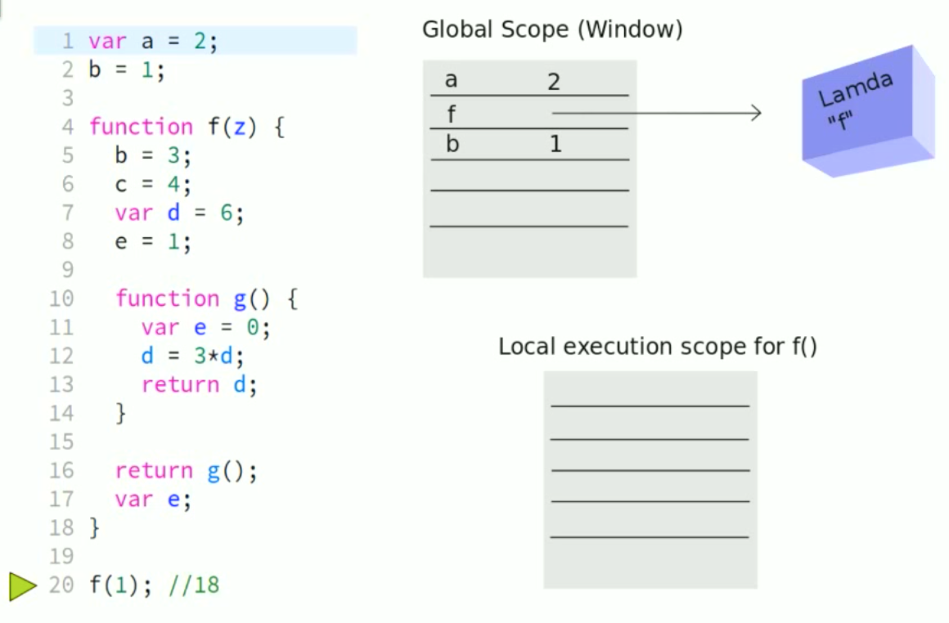
JavaScript Execution

Slide 22
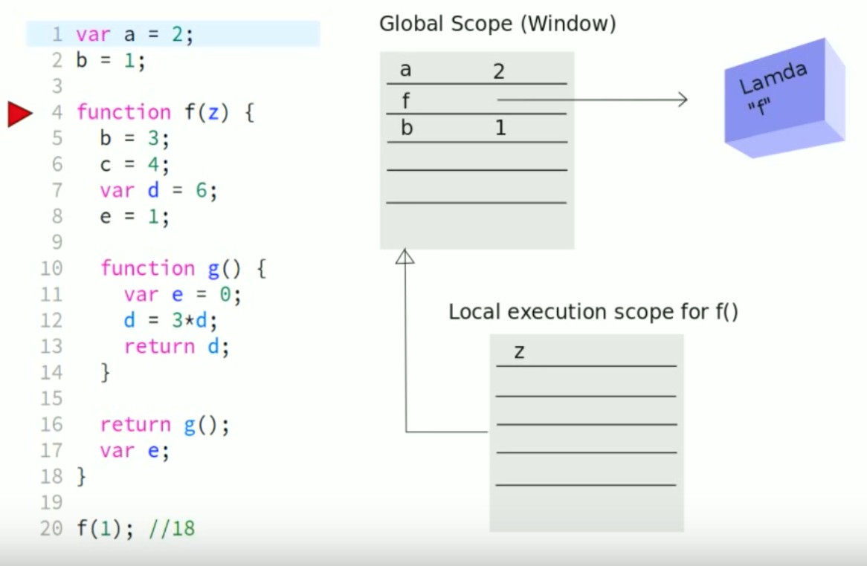
JavaScript Execution

Slide 23
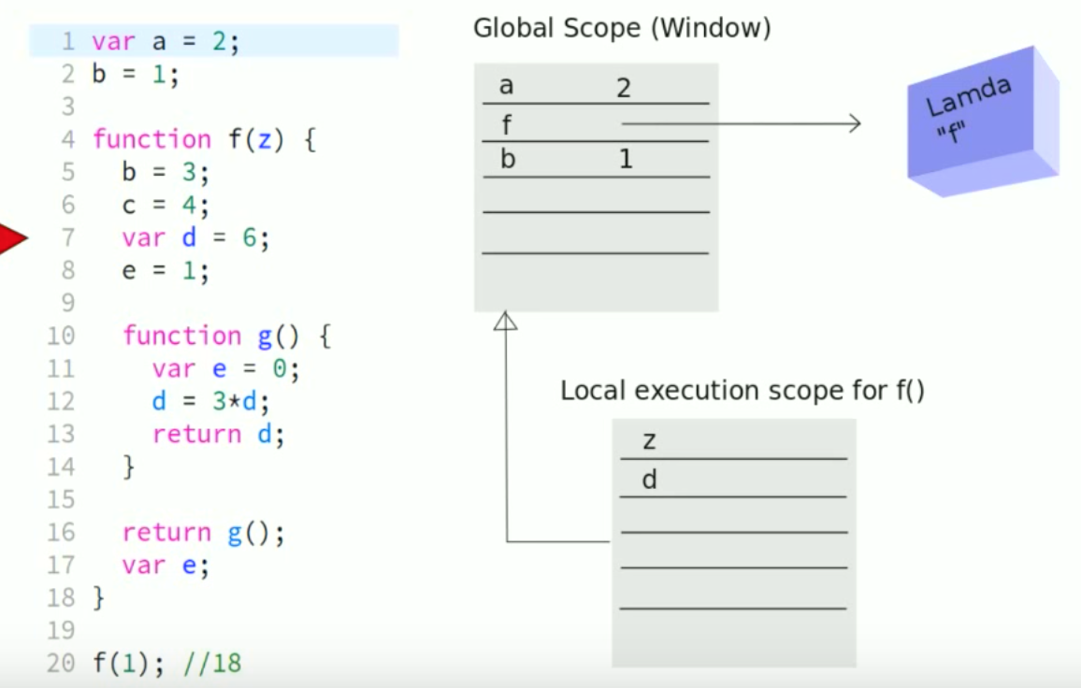
JavaScript Execution

Slide 24
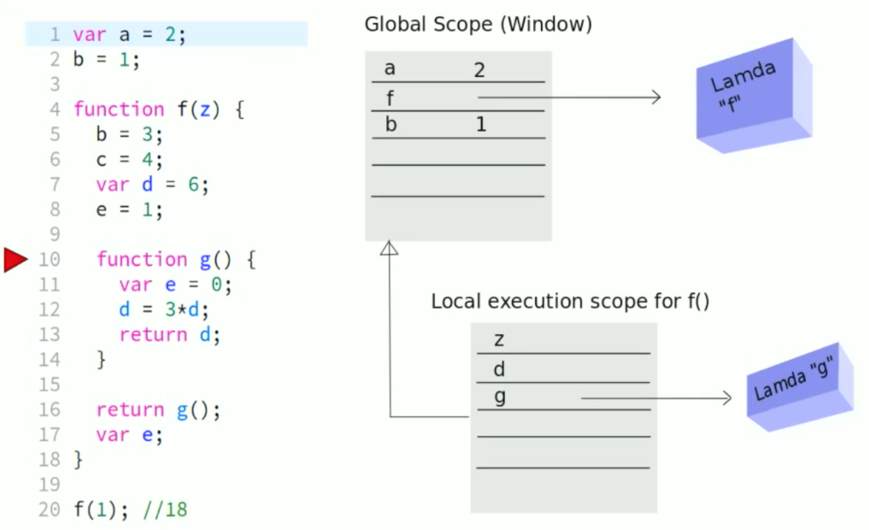
JavaScript Execution

Slide 25
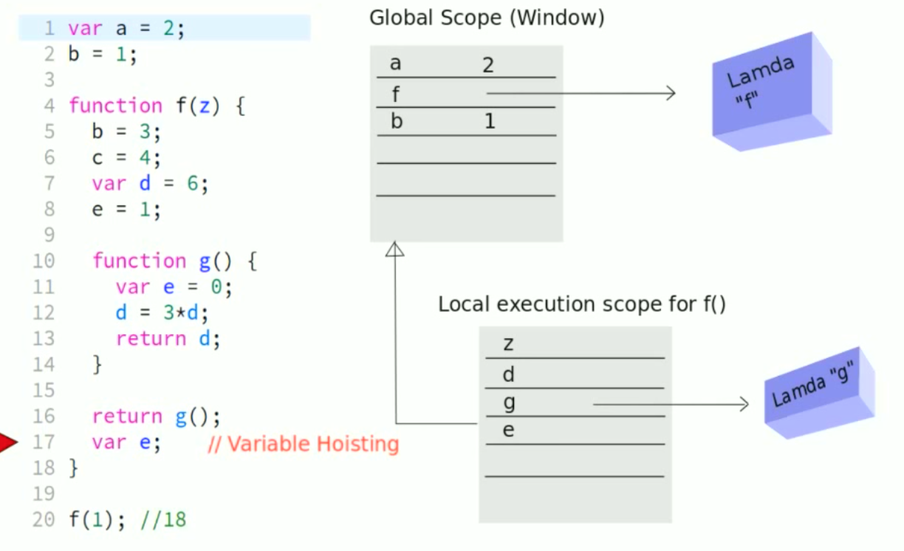
JavaScript Execution

Slide 26
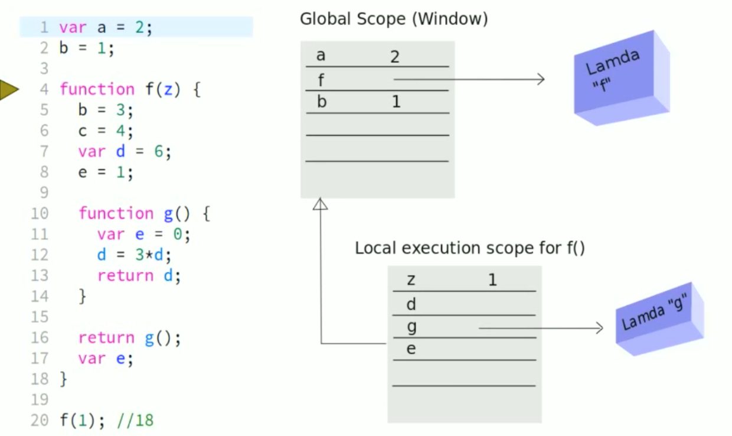
JavaScript Execution

Slide 27
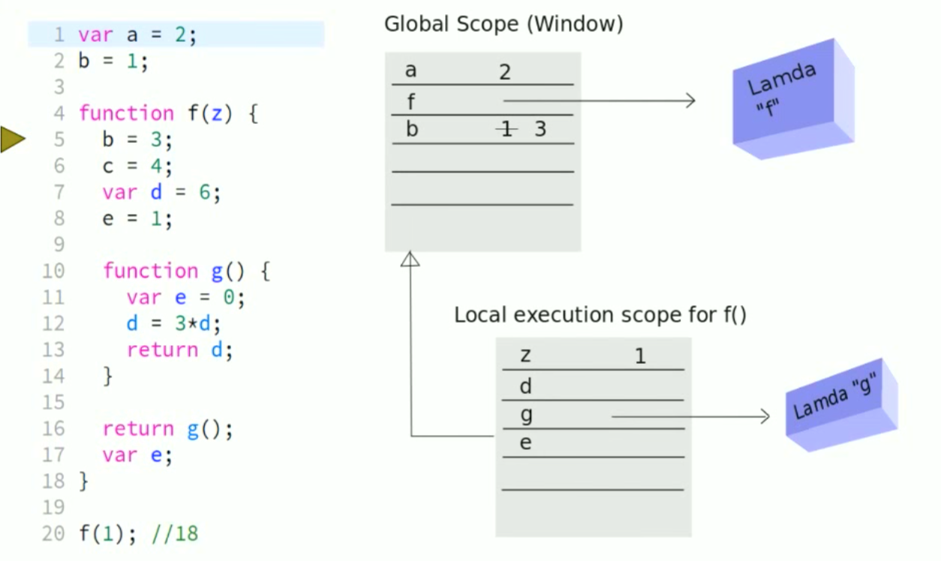
JavaScript Execution

Slide 28
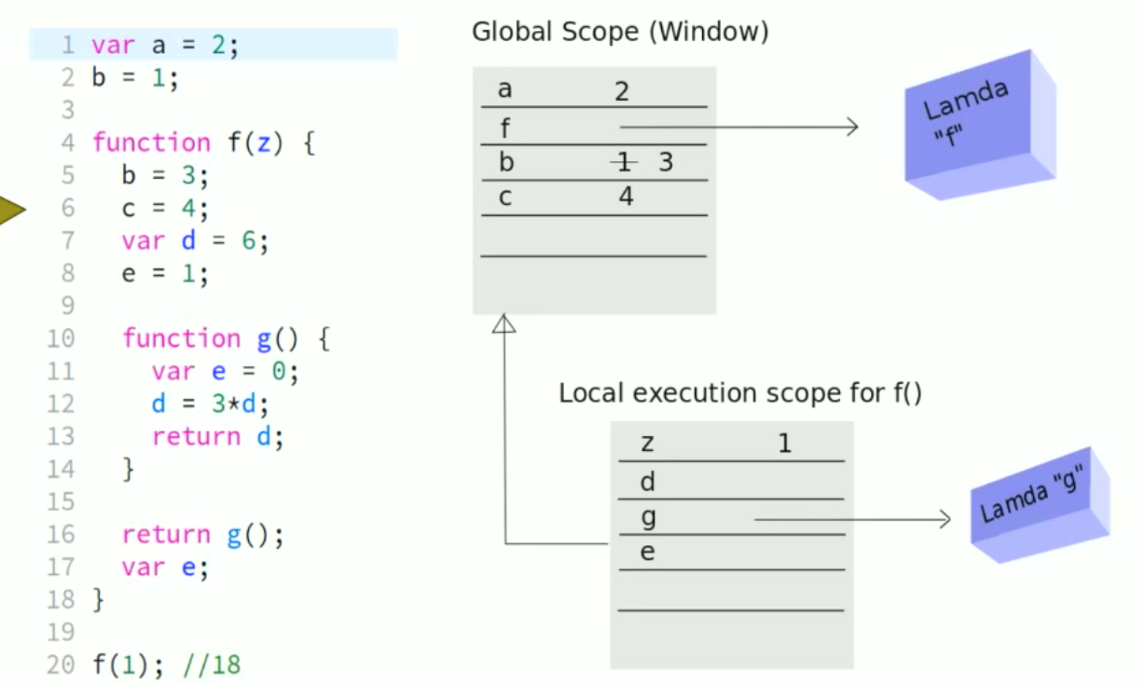
JavaScript Execution

Slide 29
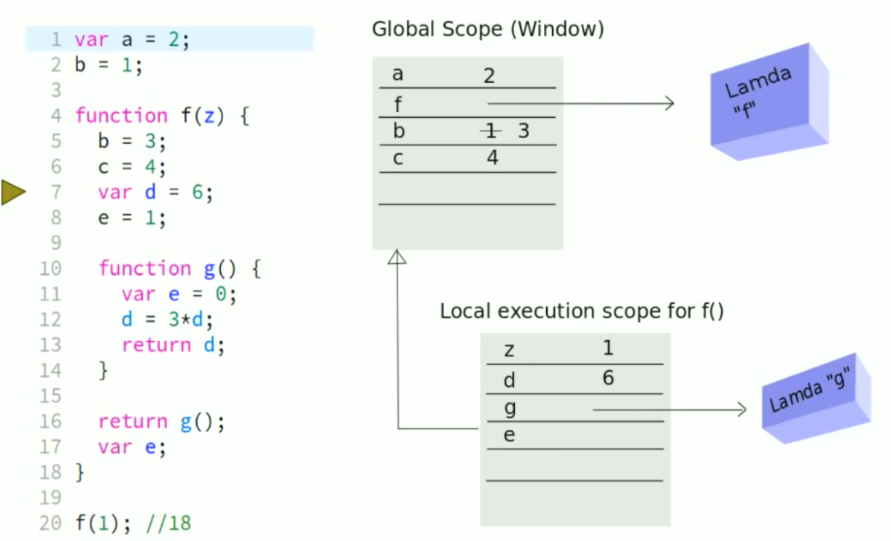
JavaScript Execution

Slide 30
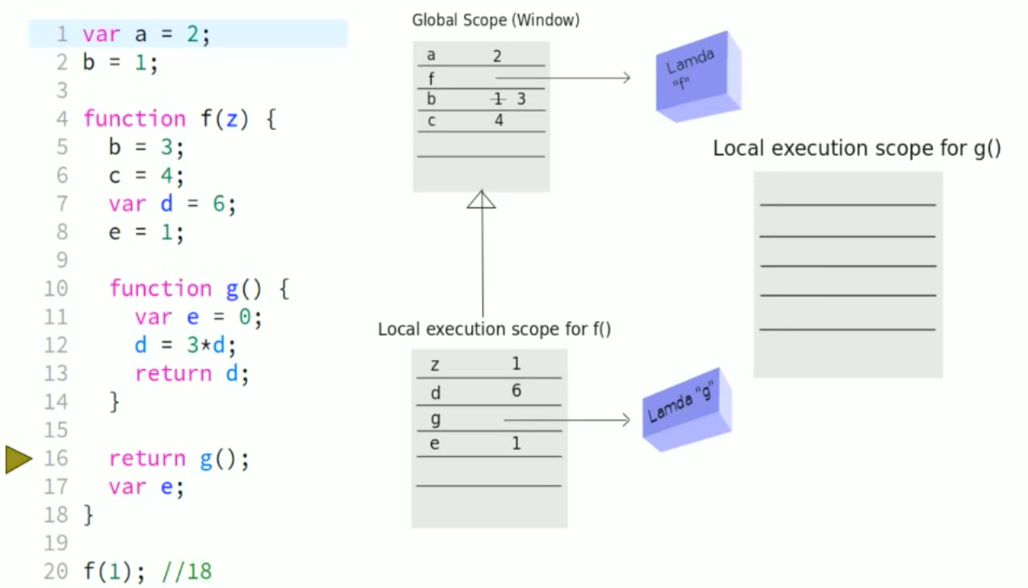
JavaScript Execution

Slide 31
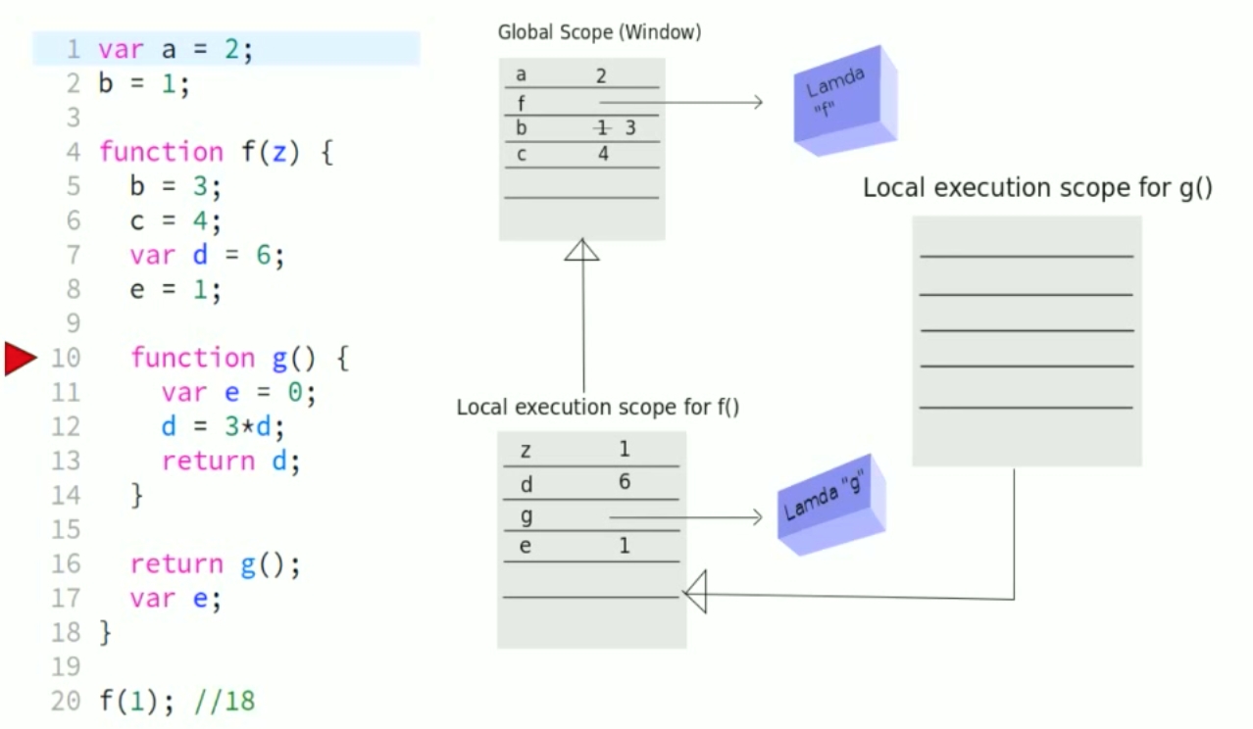
JavaScript Execution

Slide 32
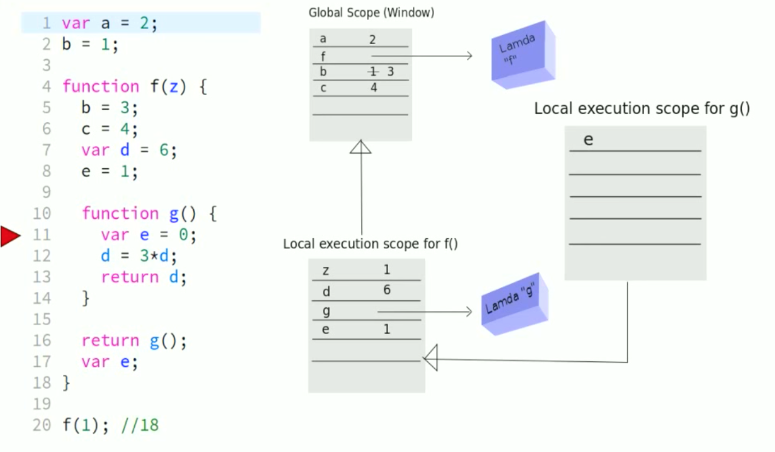
JavaScript Execution

Slide 33
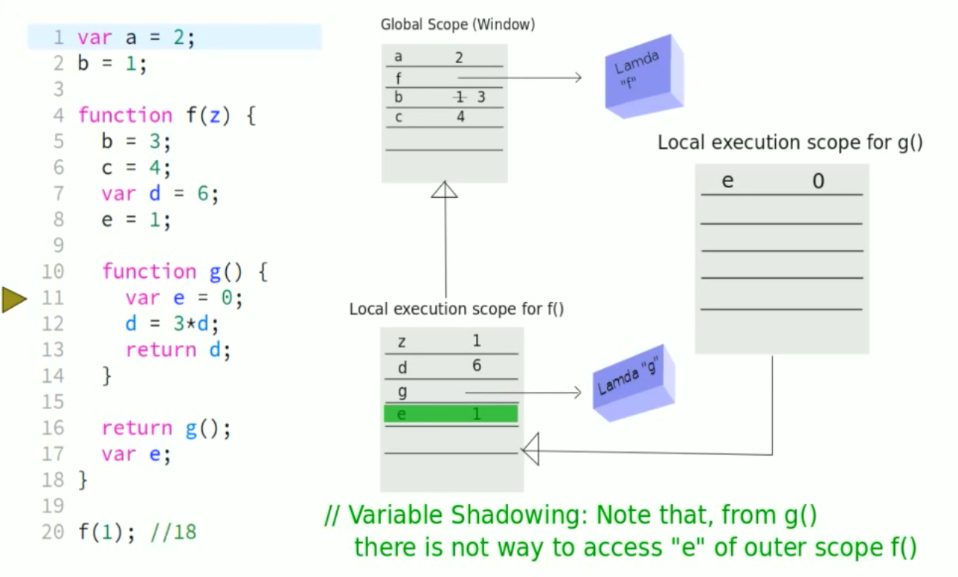
JavaScript Execution

Slide 34
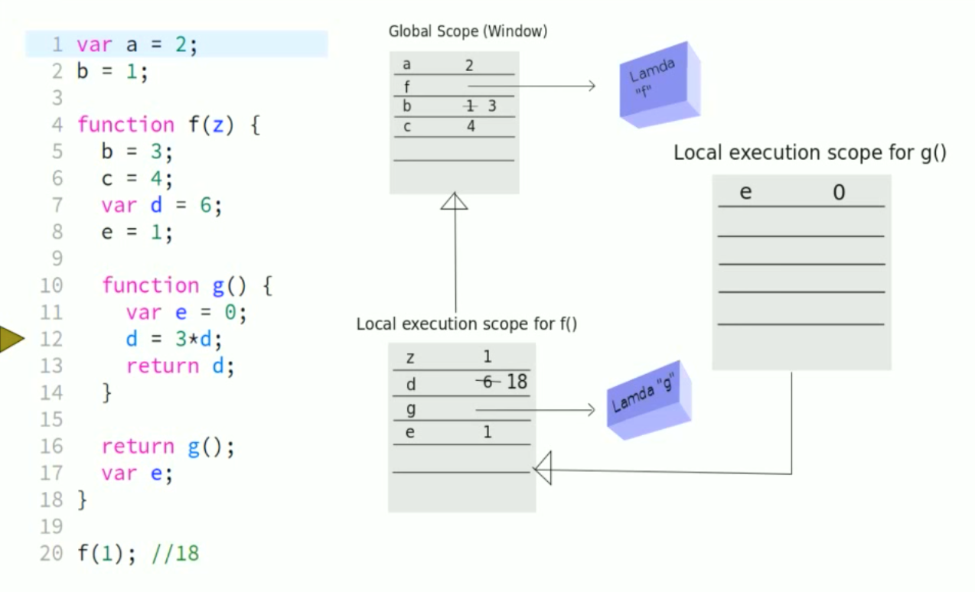
JavaScript Execution

Slide 35
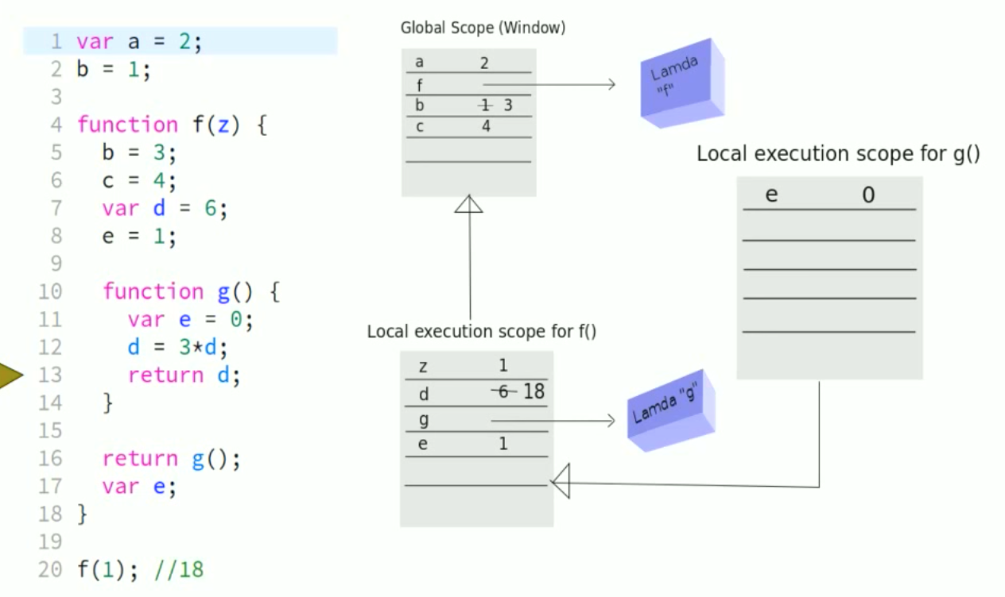
JavaScript Execution

Slide 36
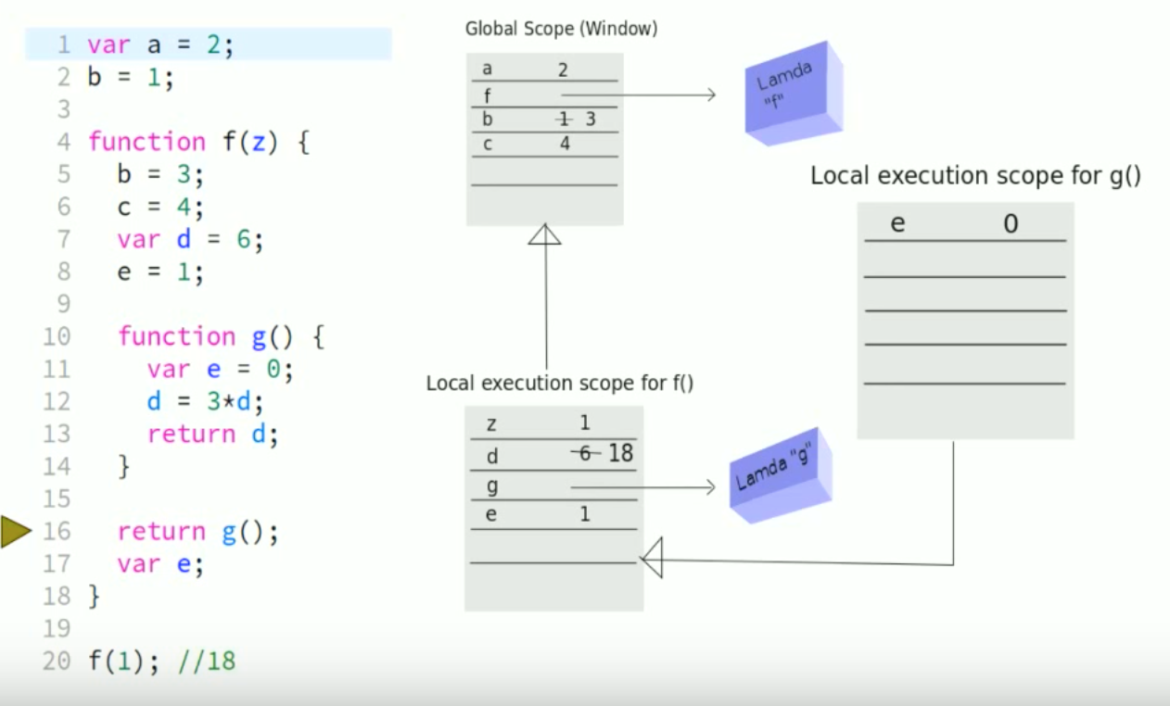
JavaScript Execution

Slide 37
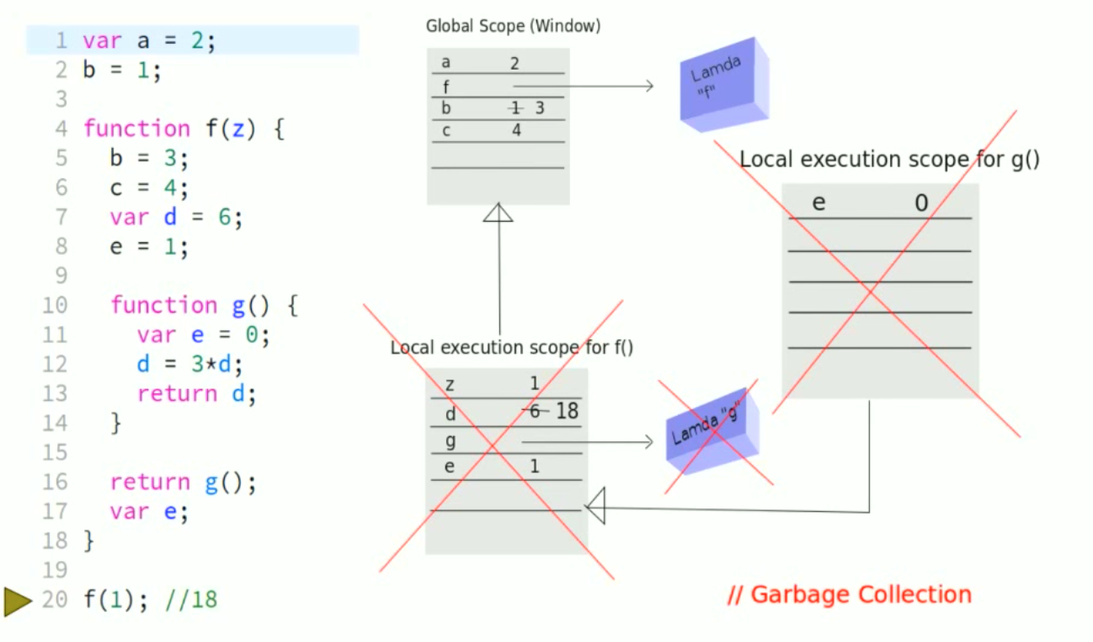
JavaScript Execution

Slide 38
Closures
A closure is an inner function that has access to the outer (enclosing) function's variables—scope chain
The closure has three scope chains:
it has access to its own scope (variables defined between its curly brackets)
it has access to the outer function's variables
and it has access to the global variables
Closure Example

Slide 39
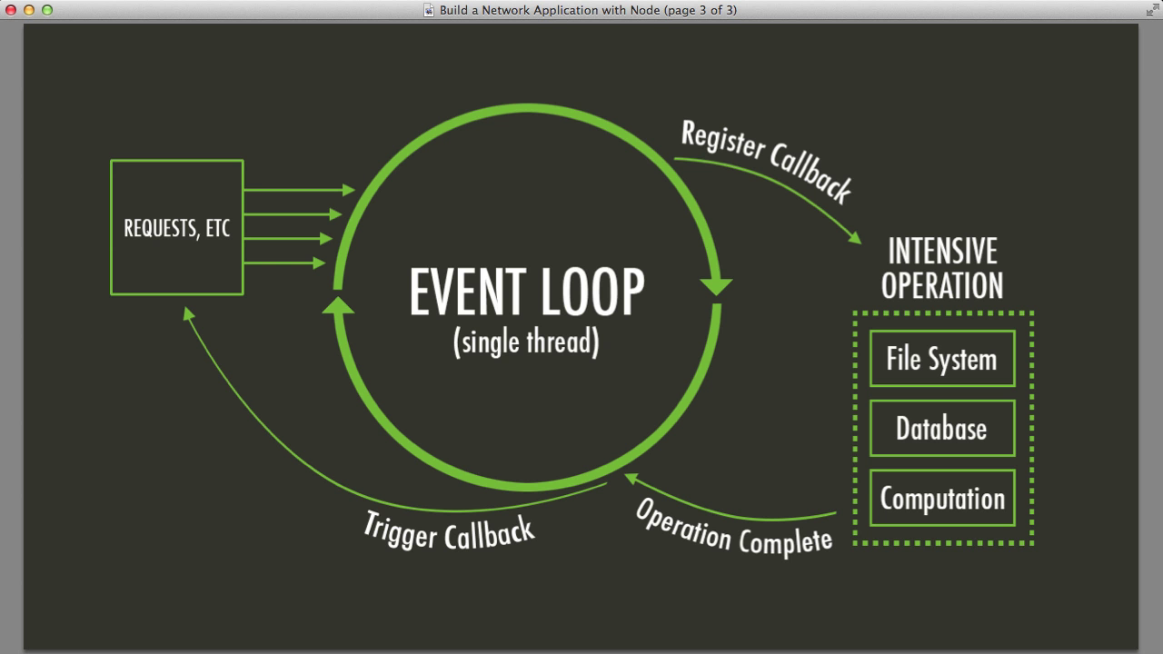
Event Loop

Slide 40
Mordern JS with ES6

Slide 41
What is ES6
ES5 did not add any new syntax
ECMAScript 6 does!
ES6 is backward compatible with ES5.
Many ES6 features provide syntactic sugar for more readable code
One Goal of ES6 is to add new features to Javascript without breaking existing implementations

Slide 42
ES6 Features
Promises
Modules
Classes
Inheritance
Block scope with let
Arrow functions
Template literals
Const
Destructuring
Async/Await ( ES 7)

Slide 43
Callback Pattern
var requestData = {some:'data'};
var url = '/path/to/service';
$.getJSON(url, requestData,
function (successData) {
//success handler
}
,function(err){
//error handler
});

Slide 44
Callback hell
step1(function(value1){
step2(value1, function(value2){
step3(value3, function(value3){
step4(value4, function(value4){
step5(value4, function(value5){
//Do Something with value 5
})
})
})
})
})

Slide 45
Promises
Promise represents a value that is not yet known.
Promise is an asynchronous value
Promise represents result of an asynchronous operation
Promise has 3 possible states
Pending
Fulfilled
Rejected

Slide 46
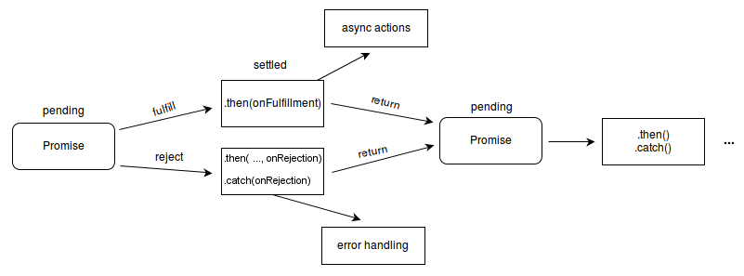
Promise states

Slide 47
Methods
Promise.all(promiseArr:[])
Wait for all promises to be resolved, or for any to be rejected.
Promise.race(promiseArr:[])
Wait until any of the promises is resolved or rejected.
Promise.reject(reason)
Returns a new Promise object that is rejected with the given reason.
Promise.resolve(value)
Returns a new Promise object that is resolved with the given value.

Slide 48
Properties
Promise.prototype.catch()
Appends a rejection handler callback to the promise, and returns a new promise resolving to the return value of the callback if it is called, or to its original fulfillment value if the promise is instead fulfilled.
Promise.prototype.then()
Appends fulfillment and rejection handlers to the promise, and returns a new promise resolving to the return value of the called handler, or to its original settled value if the promise was not handled (i.e. if the relevant handler onFulfilled or onRejected is not a function).
Promise.prototype.finally()
Appends a handler to the promise, and returns a new promise which is resolved when the original promise is resolved. The handler is called when the promise is settled, whether fulfilled or rejected.

Slide 49
Modules
Modules allows to export and import classes, functions, variables and provides a layer of abstraction.
Two ways to export from a module:
Multiple named exports
Single default export

Slide 50
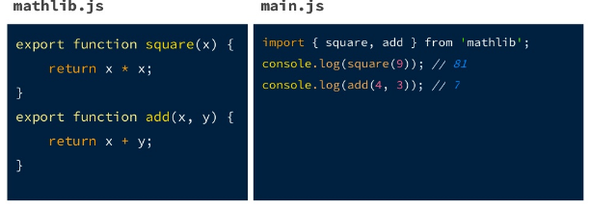
Module example

Slide 51
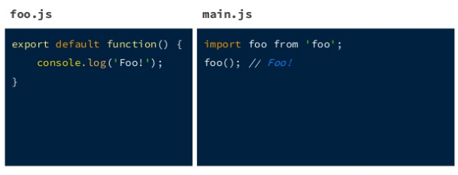
Single default module

Slide 52
Classes
ES6 introduced class keyword
ES 6
class Shape {
constructor (x, y) {
this.x = x;
this.y = y;
}
display(){
console.log(this.x, this.y);
}
}
var shapeObj = new Shape(10,20)
shapeObj.display(10,20)
ES 5 equivalent
var Shape = function (x, y) {
this.x = x;
this.y = y;
};
Shape.prototype.display = function (x, y) {
console.log(x,y);
};
var shapeObj = new Shape(10,20)
shapeObj.display(10,20)

Slide 53
Classes Inheritance
ES6 introduced extends keyword
ES 6
class Circle extends Shape {
constructor (x , y, radius) {
super(x, y)
this.radius = radius;
}
display(){
console.log(this.x,this.y,this.radius);
}
}
var circleObj = new Circle(10,20,30);
circleObj.display();
ES 5 equivalent
var Circle = function (x, y, radius) {
Shape.call(this, x, y);
this.radius = radius;
};
Circle.prototype.display = function(){
console.log(this.x, this.y, this.radius)
}
Circle.prototype = Object.create(Shape.prototype);
Circle.prototype.constructor = Circle;

Slide 54
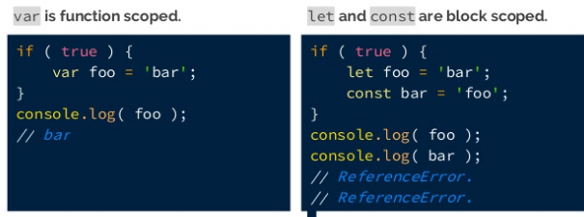
Block Scope with let
ES6 introduced let and const keyword

Slide 55
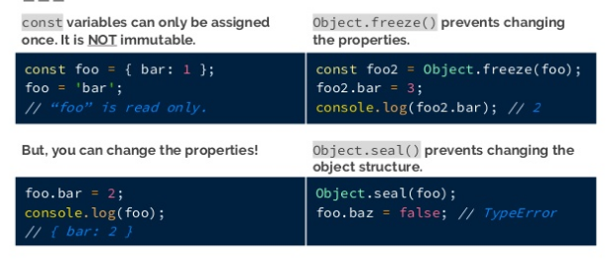
Const

Slide 56
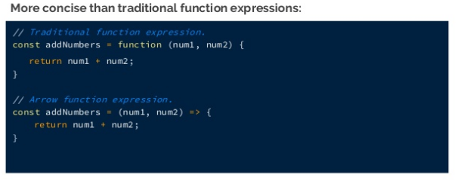
Arrow functions

Slide 57
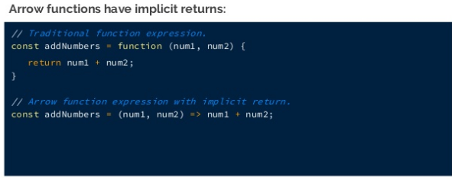
Fat Arrow Function

Slide 58
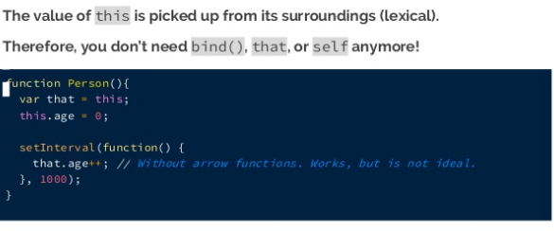
Arrow function scoping

Slide 59
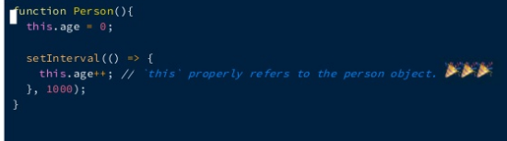
Arrow function scoping

Slide 60
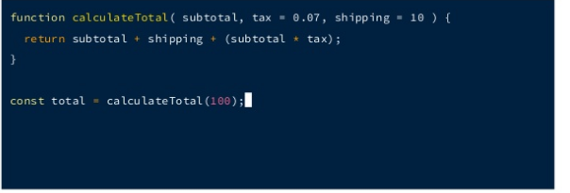
Default Arguments

Slide 61
Destructuring
Destructuring object
const settings = { color: 'white', height: 100, width: 300}
const { width, height, color} = settings; //create 3 separate consts
Destructuring Array
const details = ['swapnil', 'navalakha', 'linkswapnil@yahoo.co.in']
const [first, last, emailId] = details;

Slide 62
...Spread Operator
Spread syntax allows an iterable such as an array expression or string to be expanded in places where zero or more arguments
function sum(x, y, z) {
return x + y + z;
}
const numbers = [1, 2, 3];
console.log(sum(...numbers));
// expected output: 6
var arr1 = [0, 1, 2];
var arr2 = [3, 4, 5];
arr1 = [...arr1, ...arr2]; // arr1 is now [0, 1, 2, 3, 4, 5]
var arr3 = [3, ...arr1, 5];

Slide 63
Template literals
Template literals allows to construct string using variable values.
var customer = { name: "Foo" }
var card = { amount: 7, product: "Bar", unitprice: 42 }
var message = `Hello ${customer.name},
want to buy ${card.amount} ${card.product} for
a total of ${card.amount * card.unitprice} bucks?`
// ES5 Variants
var message = "Hello " + customer.name + ",\n" +
"want to buy " + card.amount + " " + card.product + " for\n" +
"a total of " + (card.amount * card.unitprice) + " bucks?";

Slide 64
ES6 Assignment
https://codepen.io/linkswapnil/pen/YzKxYab

Slide 65
Build Tools

Slide 66
Transpilation Babel
Transpilation is a process of converting code from one form to other maintaining the same language.
Babel is javascript transpiler that converts edge javascript into plain old ES5 javascript which can run any browser.
Most of modern application use babel to convert ES6+ code into ES5.
Helps us to use modern ES features without worrying about browser support.

Slide 67

Popular Build Tools

Slide 68

WEBPACK

Slide 69
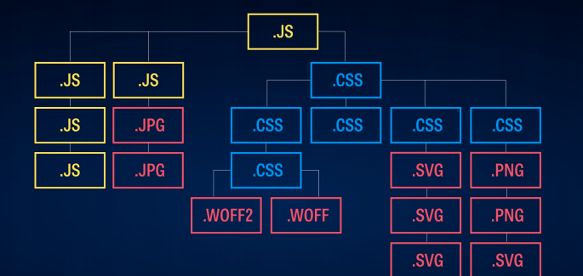
WEBPACK

Slide 70
NodeJS

Slide 71
What is NodeJS
Node.js is a platform built on Chrome's JavaScript runtime for easily building fast and scalable network applications.
Node.js uses an event-driven, non-blocking I/O model that makes it lightweight and efficient, perfect for data-intensive real-time applications that run across distributed devices.
Node was originally born out of this problem — how can you handle two things at the same time

Slide 72
History of Node…
Created by Ryan Dhal engineer at Joyent
Working on making RAILS faster
Rails problem server shutoffs until request completes – zero concurrency
Needed an non blocking event driven language
JavaScript was the language of choice

Slide 73
Why NodeJS
Increases developers productivity
Allows Isomorphic programming
Reduces Infrastructure cost
Increases collaboration
High Performance

Slide 74
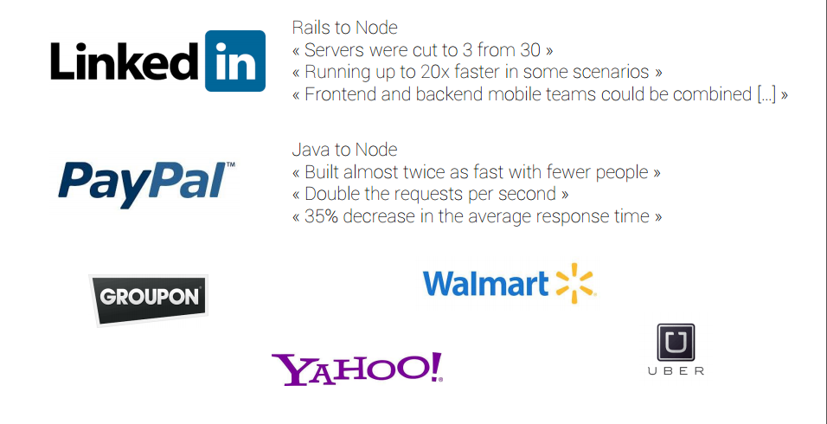
Who is using node…

Slide 75
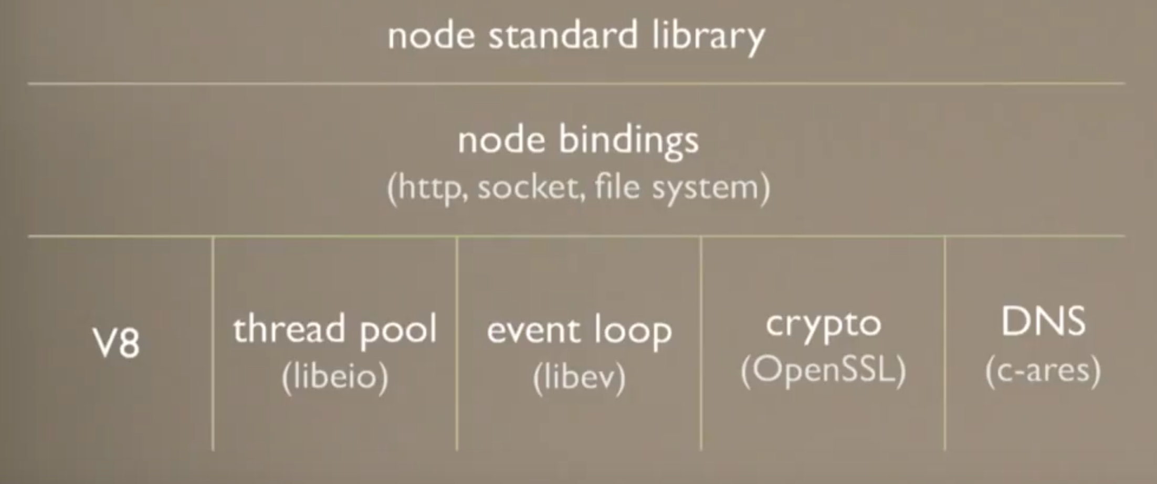
Platform

Slide 76
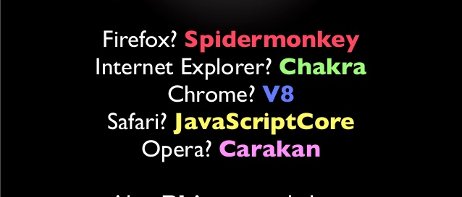
JavaScript Engines

Slide 77
Disadvantages of Node
The callback mess
Debugging is difficult
Programmer have to think Asynchronously
Can’t be used for large processing applications

Slide 78
Blocking Vs Non Blocking
JavaScript is single threaded
Blocking refers to operations that block further execution until that operation finishes
Non-blocking refers to code that doesn't block execution

Slide 79
Sync Vs Async
// Synchronous:
alert(1);
alert(2);
alert(3);
// Asynchronous:
alert(1);
setTimeout(() => alert(2), 0);
alert(3);

Slide 80
Node Modules
A Module is something that can be loaded with require()
Core Node Modules eg http, fs, stream etc.

Slide 81
NPM
Node uses NPM for dependency management
NPM comes as default with Node installation
Repository location http://registry.npmjs.org/npm
NPM makes it easy to share code

Slide 82
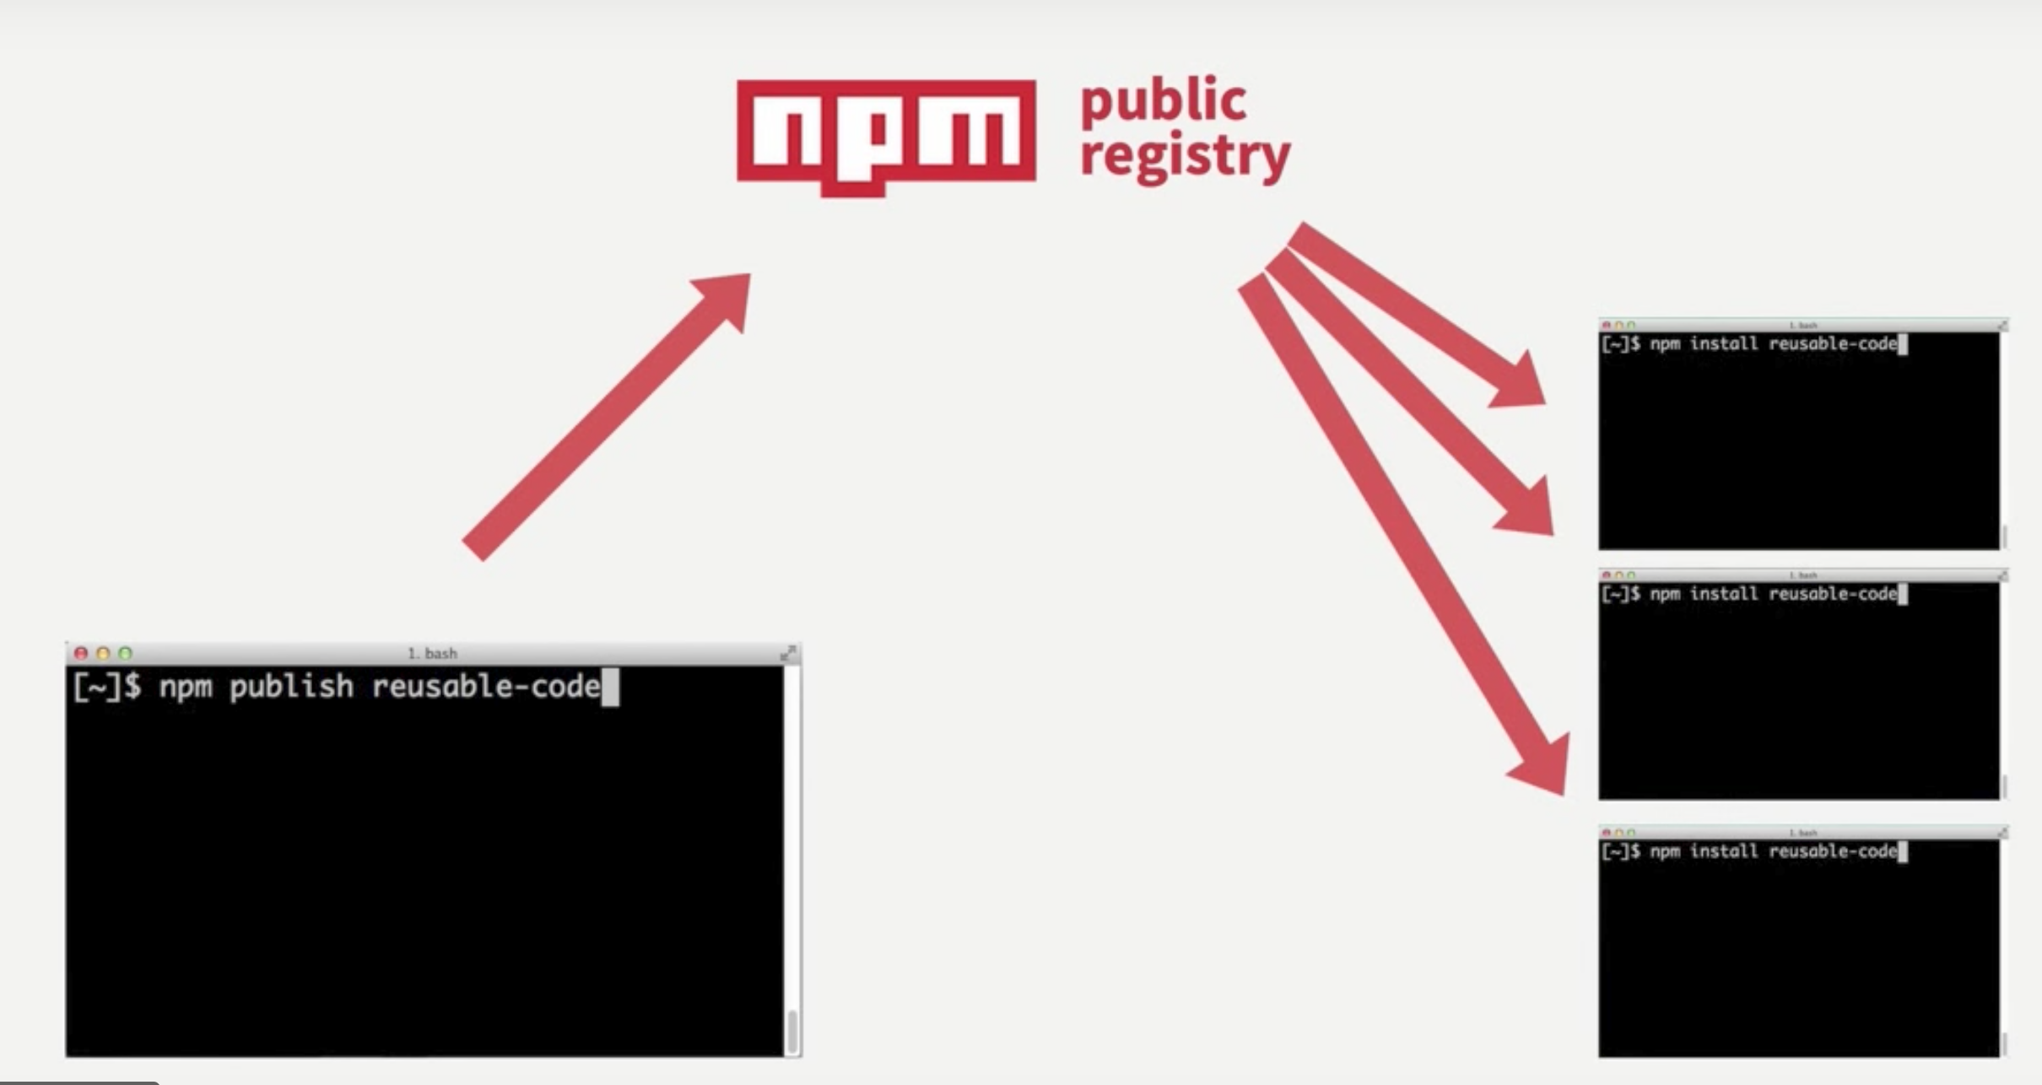
NPM

Slide 83
Creating a node module
npm init

Slide 84
Semantic Versioning
X.Y.Z
Breaking Change
(Major)
New Features
(Minor)
^
Bug Fixes
(Patch)
~

Slide 85
Publishing Module
Create an NPM account
https://www.npmjs.com/signup
npm login
npm publish
Checkout https://www.npmjs.com/~username

Slide 86
Unit Testing

Slide 87


Slide 88
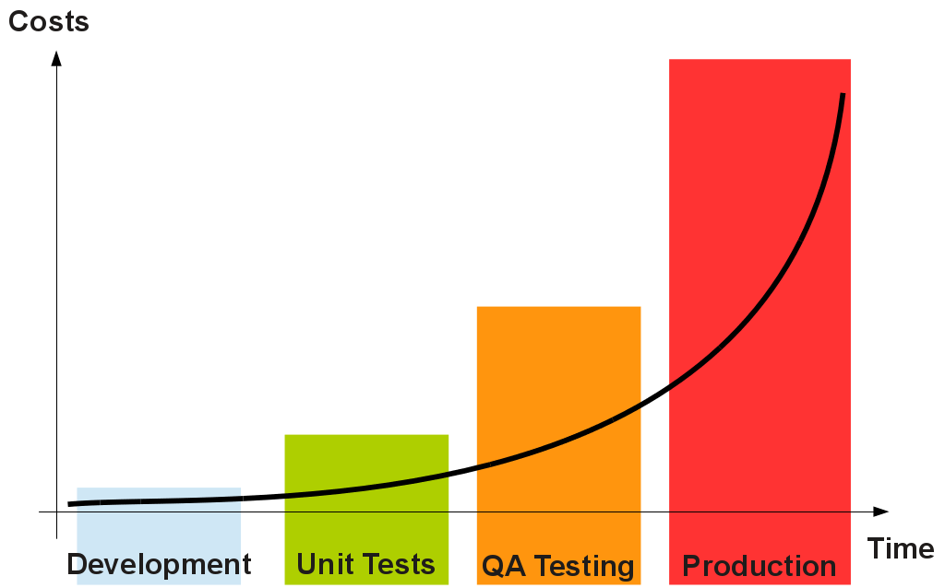

Slide 89
Why test?
Tests reduces Bugs
Test are good documentation
Test allow safe refactoring
Test reduce the cost of change
Testing forces you to think

Slide 90
Unit testing tools
Test Runner -> Mocha.js
Assertion Framework -> chai.js
Stubbing/Mocking tools -> sinon.js

Slide 91
Anatomy of unit test
Setup
assert
cleanup

Slide 92
Mocha.js
Setup
assert
cleanup
before()
beforeEach()
it()
after()
afterEach()

Slide 93
Unit testing tools
Test Runner -> Mocha.js
Assertion Framework -> chai.js
Stubbing/Mocking tools -> sinon.js

Slide 94
Chai.js - assertions
expect( <this> ).to.<assertion>(that)
Throws an Error if the assertion is false!
Examples:
expect(user.score).to.be.above(100)
expect(installer).to.have.property(‘publisher’)
expect(obj).to.equal({a:1})

Slide 95
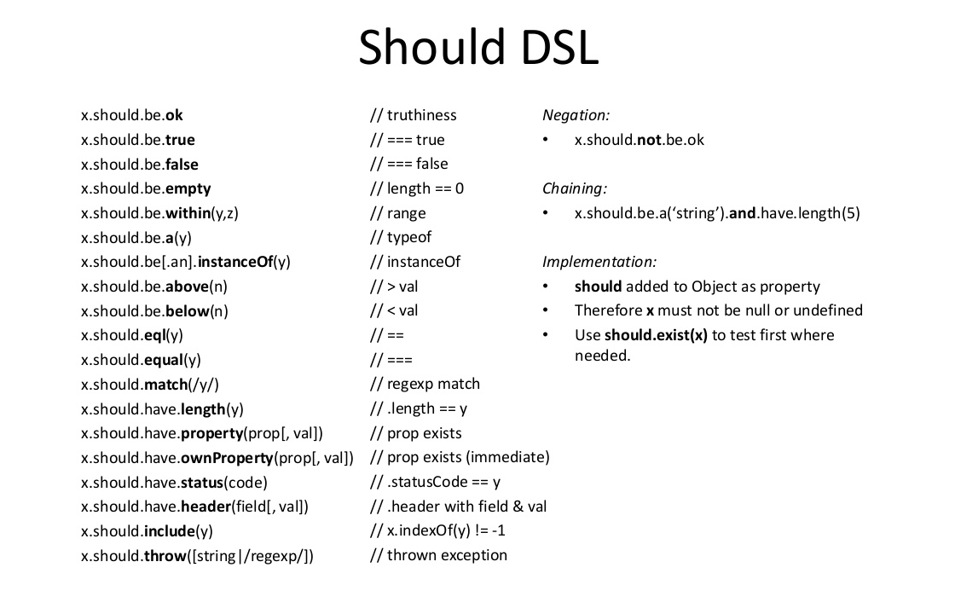

Slide 96
Write TEST for our Module

Slide 97
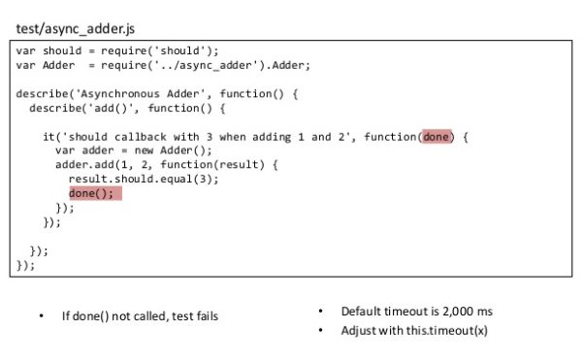
Test Asynchronous functions

Slide 98
Sinon - Stub and Mock
Test stubs are functions (spies) with pre-programmed behavior.
Stubs wrap existing functions. When wrapping an existing function with a stub, the original function is not called.
https://sinonjs.org/releases/v7.4.1/stubs/

Slide 99
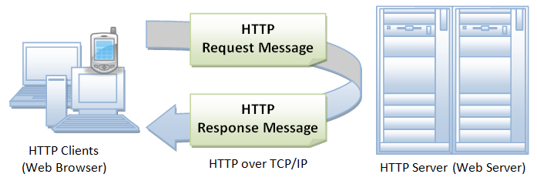
HTTP Request Response Model

Slide 100
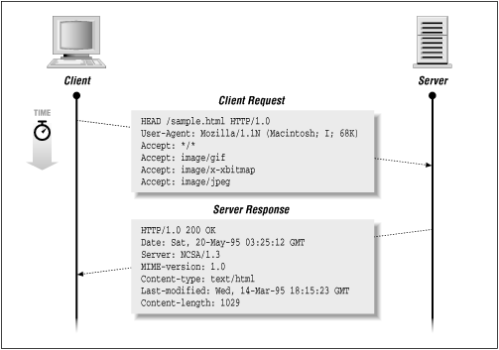
HTTP Transaction

Slide 101
Methods
Method
Get
Returns object
Head
Returns information about object
Post
Sends information to be stored on server or as input to script
Put
Sends new copy of existing object to server
Delete
Deletes object

Slide 102
Response Codes
Status-codes 2xx - Success
The action was successfully received, understood, and accepted
200 OK
201 POST command successful
202 Request accepted
203 GET or HEAD request fulfilled
204 No content

Slide 103
Response Codes
Status-codes 3xx - Redirection
Further action must be taken in order to complete request
300 Resource found at multiple locations
301 Resource moved permanently
302 Resource moved temporarily
304 Resource has not modified (since date)

Slide 104
Response Codes
Status-codes 4xx - Client error
The request contains bad syntax or cannot be fulfilled
400 Bad request from client
401 Unauthorized request
402 Payment required for request
403 Resource access forbidden
404 Resource not found
405 Method not allowed for resource
406 Resource type not acceptable

Slide 105
Response Codes
Status-codes 5xx - Server error
The server failed to fulfill an apparently valid request
500 Internal server error
501 Method not implemented
502 Bad gateway or server overload
503 Service unavailable / gateway timeout
504 Secondary gateway / server timeout

Slide 106
Creating Simple HTTP Server

Slide 107
Express
Node has a built in http module that allows us to create a server. The problem is that configuration and the amount of code you have to write in order to have basic features is pretty overwhelming and at times and difficult.
Web application framework for Node.js.
Light-weight and minimalist
Provides boilerplate structure & organization for your web-apps

Slide 108
Express Features
MVC
Routing
Session Support
Cookie Parsing
Middleware
View Engines (Pub , ejs, Vash, etc)

Slide 109
File Stream
Node provides inbuilt fs (file stream) module to interact with file system
Fs Api Documentation

Slide 110
Agenda for Day 3
Introduction to nosql and Mongodb
Using Mongodb with Node.js
Creating CRUD REST services using Express and file system.

Slide 111
Agenda for Day 3..
Introduction to Web Sockets
Creating Chat server Application using Node.js

Slide 112
NoSQL

Slide 113
Why NoSql
NoSql came around 2008 – 2009
Problems with Sql databases :
Scalability
Flexibility
Cost
Not Suitable for startups

Slide 114
Sql Characteristics
Data stored in columns and tables
Relationships represented by data
Data Manipulation Language
Data Definition Language
Transactions
Abstraction from physical layer

Slide 115
Transaction
Atomic – All of the work in a transaction completes (commit) or none of it completes
Consistent – A transaction transforms the database from one consistent state to another consistent state. Consistency is defined in terms of constraints.
Isolated – The results of any changes made during a transaction are not visible until the transaction has committed.
Durable – The results of a committed transaction survive failures

Slide 116
Sql Database Examples
Commercial
IBM DB2
Oracle RDMS
Microsoft SQL Server
Sybase SQL Anywhere
Open Source (with commercial options)
MySQL
Ingres

Slide 117
NoSql Defination
From www.nosql-database.org:
Next Generation Databases mostly addressing some of the points: being non-relational, distributed, open-source and horizontal scalable. The original intention has been modern web-scale databases. The movement began early 2009 and is growing rapidly. Often more characteristics apply as: schema-free, easy replication support, simple API, eventually consistent / BASE (not ACID), a huge data amount, and more.

Slide 118
NoSql Distinguishing Characteristics
Large data volumes
Google’s “big data”
Scalable replication and distribution
Potentially thousands of machines
Potentially distributed around the world
Queries need to return answers quickly
Mostly query, few updates
Asynchronous Inserts & Updates
Schema-less
ACID transaction properties are not needed – BASE
Open source development

Slide 119

Popular NoSql Databases

Slide 120
MongoDB
It is a document database
Its open source cross platform
There is no RDBMS Concept here and data is stored in a flat file system
MongoDB uses JSON like documents for creating new tables or collections in database

Slide 121
Where to use MongoDB
You need High Availability in an Unreliable Environment (Cloud and Real Life)
You need to Grow Big (and Shard Your Data)
Your Data Set is Going to be Big (starting from 1GB) and Schema is Not Stable
You Don't have a DBA

Slide 122

Companies using MongoDB

Slide 123
MongoDB terminologies
> db.user.findOne({age:39})
{
"_id" : ObjectId("5114e0bd42…"),
"first" : ”Xyz",
"last" : ”N",
"age" : 29,
"interests" : [
"Reading",
"Mountain Biking ]
"favorites": {
"color": "Blue",
"sport": "Soccer"}
}
RDBMS |  | MongoDB
Database |  | Database
Table, View |  | Collection
Row |  | Document (JSON, BSON)
Column |  | Field
Index |  | Index
Join |  | Embedded Document
Foreign Key |  | Reference
Partition |  | Shard
<number>

Slide 124
Installing mongodb
https://docs.mongodb.com/manual/tutorial/install-mongodb-on-windows

Slide 125
Socket.io
Going Realtime with Socket.io
PRALUV TECH

Slide 126

Traditional HTTP Server

Slide 127
What are Web Sockets
Web Socket is a communications protocol, providing full-duplex communication channels over a single TCP connection.
A socket is a endpoint for connection
Client and Server both have Sockets
A port is 16-bit integer that identify a process
Some ports are well known eg. Port 80 is associated to a webserver

Slide 128

Full Duplex Communication

Slide 129

Broadcasting messages

Slide 130
Socket.io apis
http://devdocs.io/socketio

Slide 131
Persisting Data With Redis

Slide 132
What is Redis
Redis is a key value store
It supports data structures such as strings, hashes, lists, sets, sorted sets with range queries, bitmaps, hyperlogs and geospatial indexes with radius queries.
It provides non blocking apis
https://redis.io

Slide 133
Connect with me
https://www.linkedin.com/in/swapnil-navalakha-9537384a/
swapnilnavalakha2010@gmail.com

